Slide 1
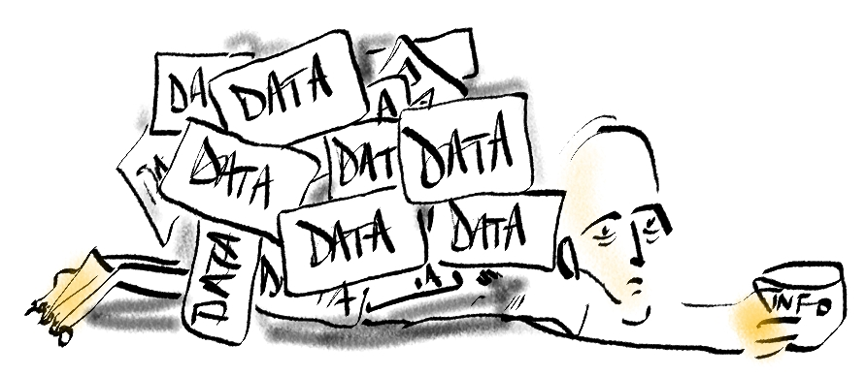
Data to Decisions:
What’s meaningful to you?

Slide 2

WHY are we doing Data to Decisions (D2D) 1.0?
D2D 1.0 is a starting place for primary care measurement.
At a health team level
  As a summary report of indicators that are currently available and meaningful, it will show health teams where they stand relative to peers.
  It will help teams see and celebrate successes and point them to the next place to focus to advance quality of care in their own teams.
At the AFHTO membership level
  D2D 1.0 will demonstrate the leadership provided by team-based interprofessional primary care organizations.
  D2D 1.0 will give members an opportunity to influence the directions for measurement and quality improvement in primary care

Slide 3
How does D2D 1.0 fit with other initiatives?
D2D 1.0 builds on primary care measurement efforts such as:
  Primary Care Performance Measurement Framework (PCPMF) -- Expected completion by Health Quality Ontario (HQO ) mid-2014 (http://www.hqontario.ca/public-reporting/primary-care
  Starfield model -- Adopted by the AFHTO board http://www.afhto.ca/wp-content/uploads/Valuing-comprehensive-primary-care.pdf
  AFHTO QIDS Innovation projects: completed Mar 2014, knowledge transfer underway.
D2D 1.0 focuses on the current work in measurement that overlaps between health teams to maximize the value from existing efforts without further taxing scarce resources.

Slide 4
What is D2D 1.0?
D2D 1.0 is a summary of primary care data that are currently available, comparable and mean the most to members in their efforts to advance quality of care for their patients.
D2D 1.0 will help members
  Know where your team stands relative to your peers
  Celebrate the successes of your team
  Know where to start to advance quality of care in your health team

Slide 5
Who is participating?
Participation is limited to AFHTO members & is completely voluntary
There are many ways to participate
  Provide comments and ask questions
  Vote on indicators (open to all AFHTO members): Apr 24-May 8
  Discuss with your QIDSS: already in progress…
  Track D2D 1.0 indicators locally: test extractions after indicators are selected
  Contribute your data to D2D 1.0: after you review your test extracts (if any)
  Plan for D2D 2.0: any time
Members decide what level of participation works for their team

Slide 6
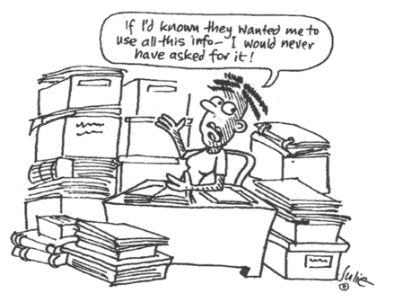
How much work will D2D 1.0 be?
D2D 1.0 will only include data that are already available
Health teams decide how much effort they can afford to contribute to the project (see different ways of participating)
The focus of D2D 1.0 is on the areas where the collective efforts between health teams overlap so everyone can get more value out of this work

Slide 7
When is the D2D 1.0 project happening ?
When did the project start?
  AFHTO Board approval Feb 2014 -- introduced to members March 2014
When will production of the D2D 1.0 report start?
  Deadline for contribution of data is Jun 30, 2014
When will D2D 1.0 be done?
  D2D 1.0 will be released by the annual AFHTO conference, Oct 15-16, 2014

Slide 8

How are indicators being selected?
Starfield/PCPMF
Extensive consultation (physicians, administrators, etc)
100’s
Indicators Working Group
Long list
existing reports defined by physicians, (eg CPCSSN, EMRald), Dorval, HQO, Champlain FHTs
QIDSS
43
Garden city
Dr survey
Got data
QIDSS, admin sources
28
11
0
What matters most

Slide 9
Group 1 Indicators (best 2 of 3)
Breast, cervical, colorectal cancer screening
(QIP indicator) Primary care follow up visit with physician within 7 days of discharge
Reduce admissions to hospitals for Ambulatory Care Sensitive Conditions
Patient experience -- various questions
Childhood immunizations
(QIP indicator) % of patients reporting same/next day appointments
# no shows of patients
18-month-old development check
Smoking cessation advice
Appropriate process of care for diabetics, hypertension and IHD patients
Reviews of patients with chronic diseases

Slide 10
Other indicators
Group 2: administrative data members might not be aware of
Reduced number of 30 day readmissions
Continuity of care
Lower acuity ED visits
Comprehensiveness of care
Cost of care
Access bonus (% of max)
Specialist visits
Group 3: data that MAY be available in health team
Influenza immunization rate
Advanced access 3rd next appt.
House calls
% of week with direct office access
% on Coumadin with INR 2-3 in past 60 days
% appointments booked on the same or previous day (from scheduling data)
Outcomes for diabetics, hypertension and IHD patients.
Follow up by a primary care provider via phone or visit within 7 days of discharge

Slide 11
How will the list of indicators be finalized?
Indicators Working Group recommendation to QIDS Steering Committee late May for decision mid June
Criteria for final list
  Meaningful: AFHTO members vote, previous votes, innovation project results, PCPMF, external partners etc
  Available: successful “test” extractions May-June, QIDSS input
  Breadth: based on # of teams contributing data by Jun 30, 2014
Notes:
carol

Slide 12
Who will help extract &/or contribute data?
QIDSS will be available to partnerships and will help via
  Their day job! Daily efforts to support Quality Improvement
  Responding to needs of health teams for data
  Collaborating with peers (via QIDSS forums)
  Accessing support from EMR vendors through Communities of Practice
  Seeking/receiving guidance from Vendor/Supply Chain of QIDS Steering Ctte
Help for AFHTO members not currently part of a QIDSS partnership
  AFHTO QIDS program staff
  Fellow AFHTO members

Slide 13
When I submit our data, who will see it?
All health-team level data will be anonymized in D2D 1.0
  Only you and report production staff will know which data is yours.
PRIVACY
  There is no information that identifies patients so no risk of breach of private health information.
CONFIDENTIALITY
  There is information specific to health teams so a confidentiality agreement will be implemented to ensure there is no breach of confidential information
OMD is the production partner.
  Long and reliable history of working with and protecting confidential data about primary care providers.

Slide 14
For more information
  D2D 1.0 FAQ: http://www.afhto.ca/wp-content/uploads/Frequently-Asked-Questions-about-D2D-1-0-Advancing-primary-care.pdf
Tim Burns, Provincial Lead, QIDS program tim.burns@afhto.ca
Carol Mulder, Practice Lead, QIDS program carol.mulder@afhto.ca
Notes:
tim

