Slide 1
Using
Fake Billing Codes to Track
IHP Workload
Melonie Mawhiney
Halton McMaster Family Health Centre

Slide 2
What We Needed
To afford staff and management the opportunity to provide the MOHLTC accurate and compressive data for our QIP, Ministry stats and workflow/volume measurement
Accurate tracking of program volumes
Accurate tracking of clinic needs for patient future programs
Tracking of program sustainability
Ability to measure staff workload and volumes
Ability to categorize by episodic, program and call tracking areas
Identification of measurable versus perceived workload
Standardization of reporting

Slide 3
What We Did
Started at the beginning of Q2 for RN and IHP staff
Set up fake billing codes in billing module
Showed staff how to use them to bill
Run reports from Report by Template

Slide 4
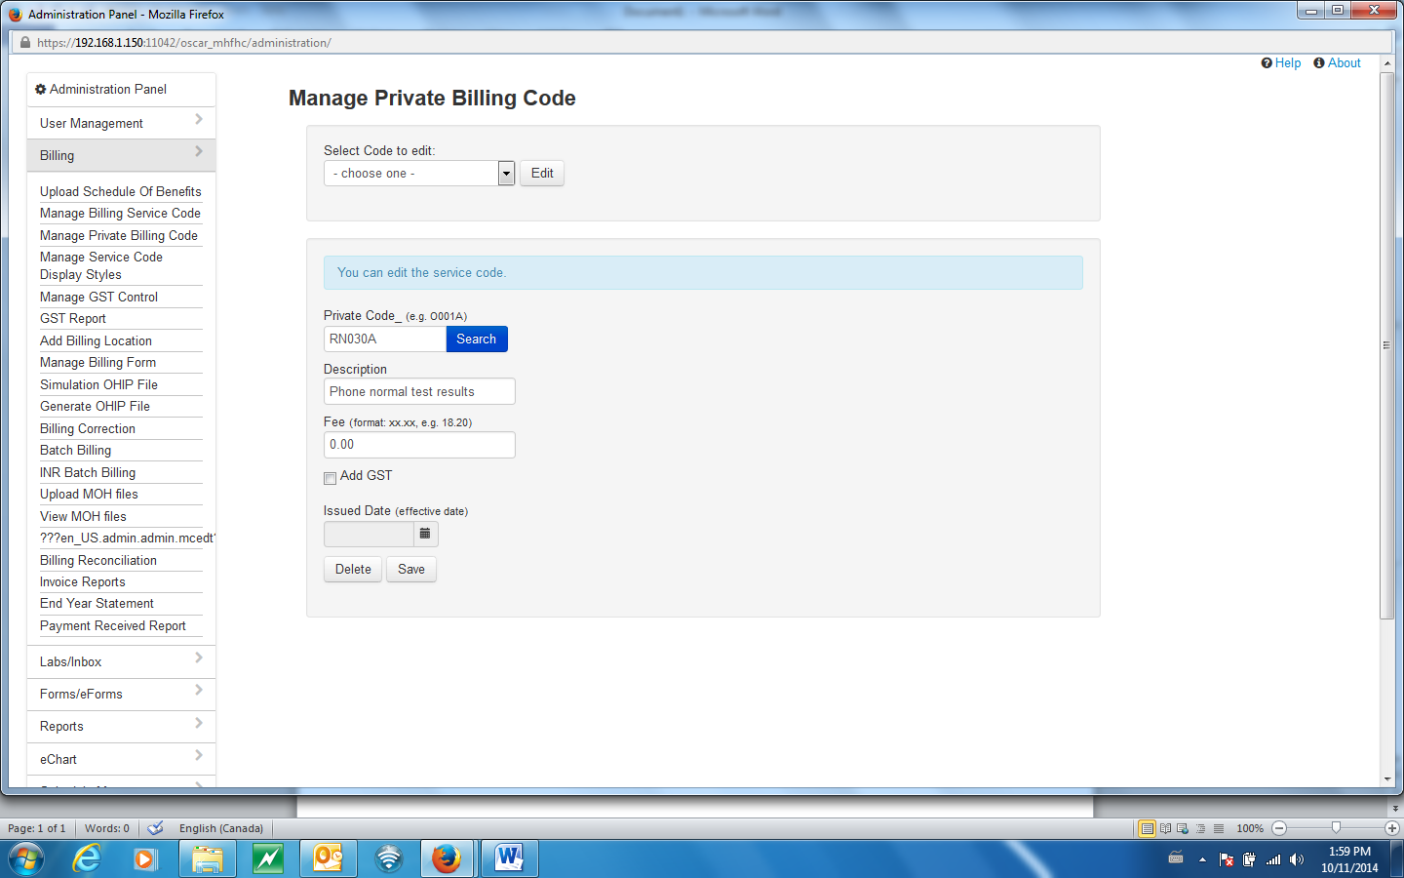
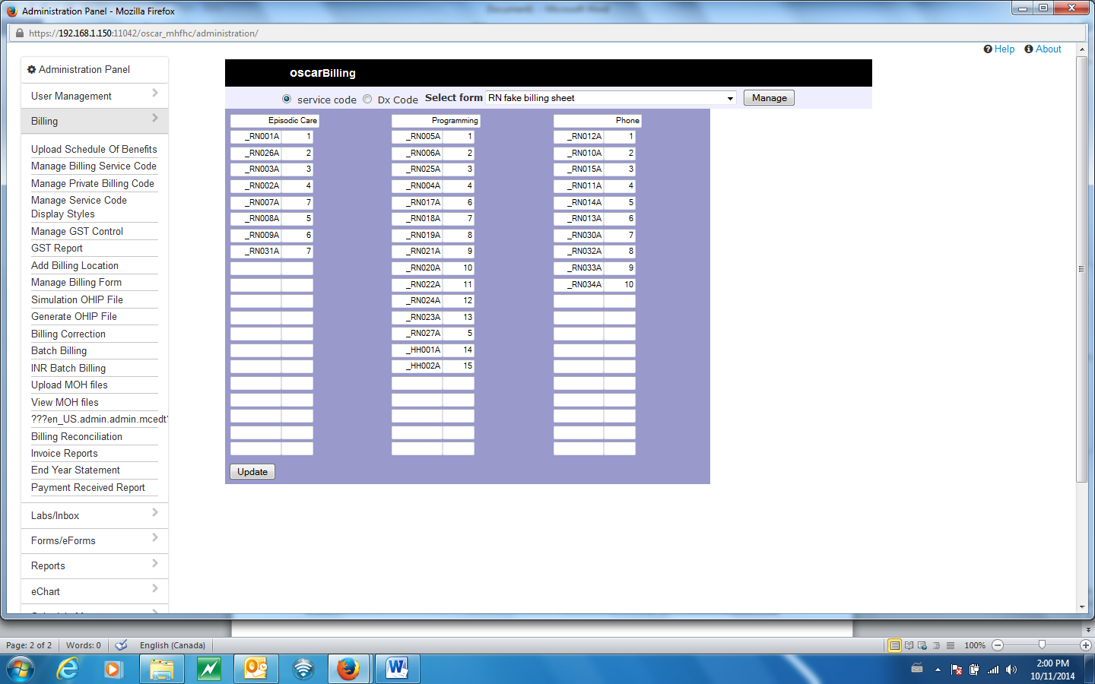
What We Did
Set up fake billing codes – Manage Private Billing Code

Slide 5
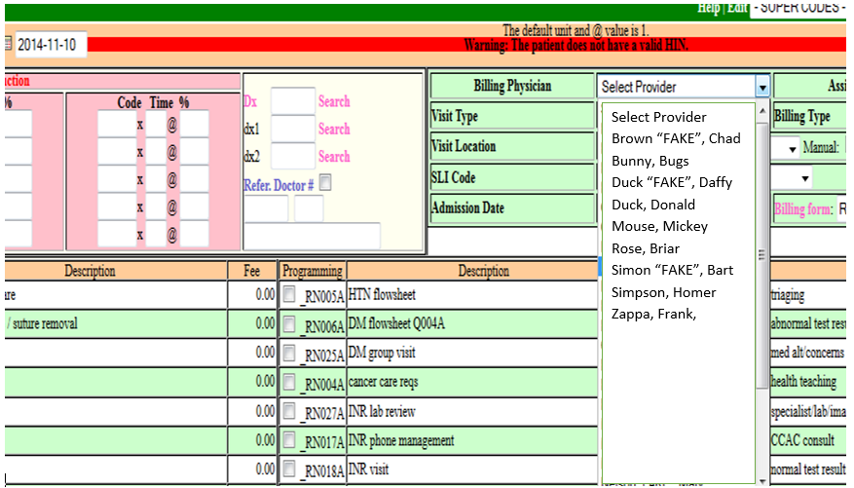
What We Did
Sign, Save Bill
Choose the appropriate BILLING FORM and FAKE PROVIDER
Bill any and all as appropriate
Click NEXT, then SAVE
IHP IS NOW FINISHED

Slide 6
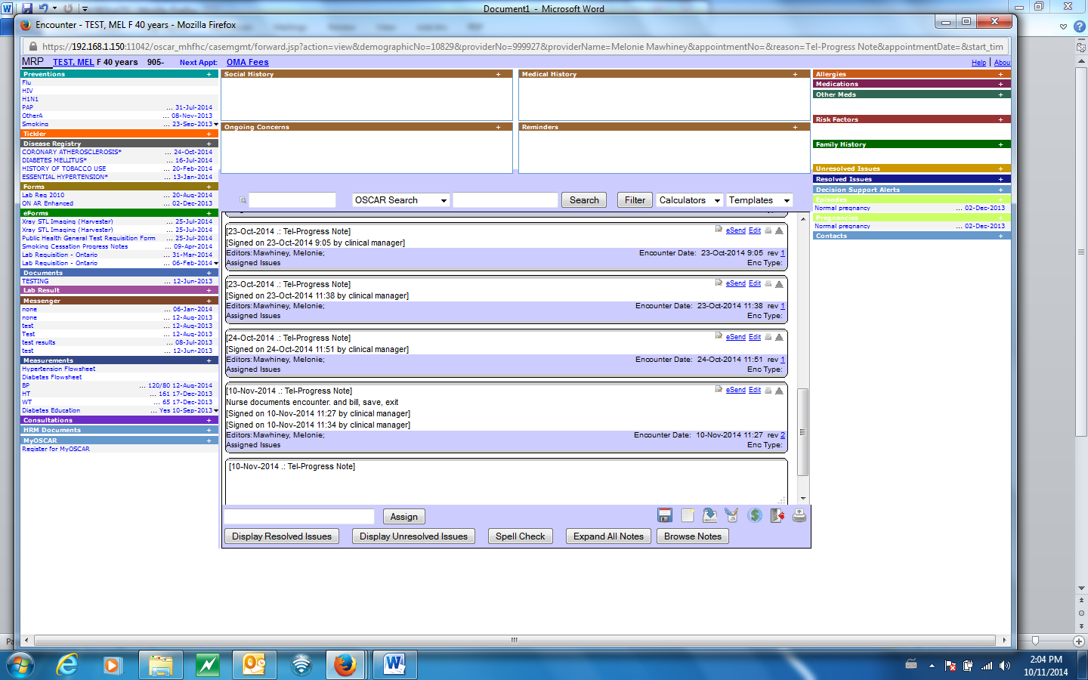
What We Did

Slide 7
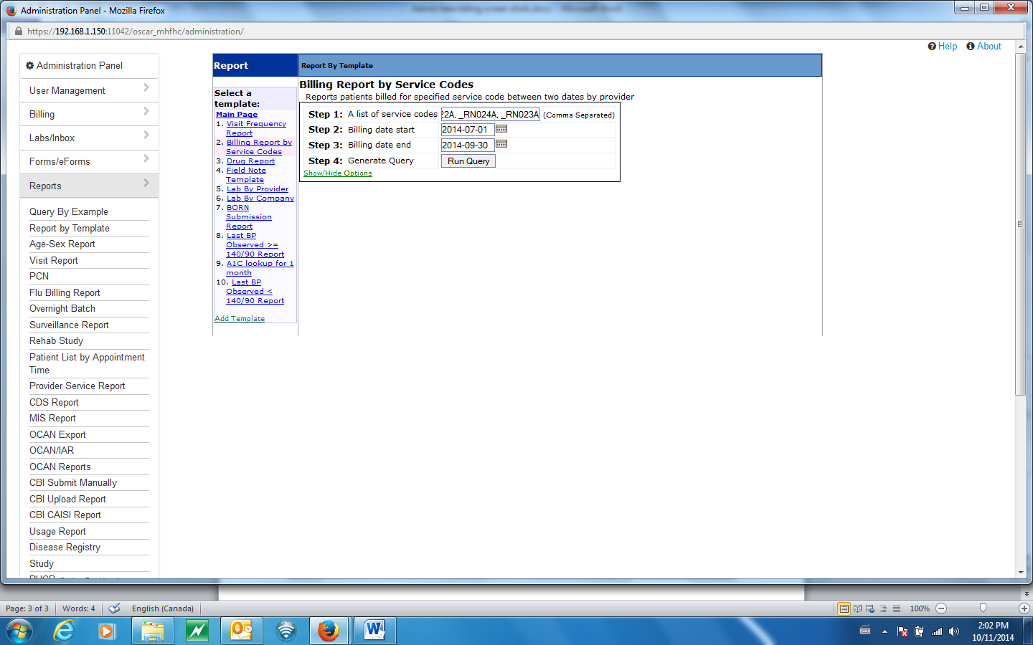
What We Did
Tracking done by Admin for:
MOHLTC Reports
QIP Measurements
Workload Measurements

Slide 8
What We Got
MOHLTC gets accurate numbers for FHT services
All documentation is billed from the progress note which requires no change to flow
Accountability, accuracy, efficiencies, measurable, reportable data in an easy organized way
Reports can be done in minutes and done as specific or general as clinic needs
Codes are identified to the appropriate IHP
Codes can be added or deleted/changed quickly
Results can be exported to excel
Results can be broken down to clinic wide volumes or by specific physician
Board/physician awareness

Slide 9
Success!
Staff
Used regularly and saves time
Each have their own billing sheets
Billing is easy and effective as it is part of their workflow
Able to customize codes to track for their own knowledge
Reports done as required and done within minutes
No longer need to track down for their quarterly reports
More encouraged to document workflow
Highlight
RN message nurse was the biggest result - from 3 RN down to 1 RN making calls
Message nurse benefits
  improved job satisfaction
  feeling of appreciation of tasks completed regardless if they are actually tracked for any other purpose

